Slide 1
Job Title broken down by Experience Level
Project 1

Slide 2
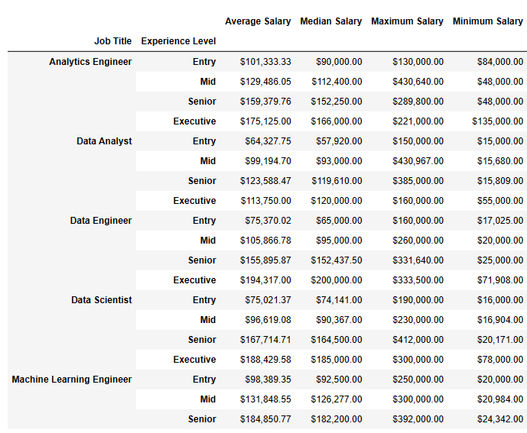
Summary Statistics Table by Job Title & Experience Level
Experience level always matches expertise level
Some job title and experience level groups have insufficient data compared to others -Data Analyst Executive: 4
-Analytics Engineer: 8
-Machine Learning Engineer: 0

Slide 3
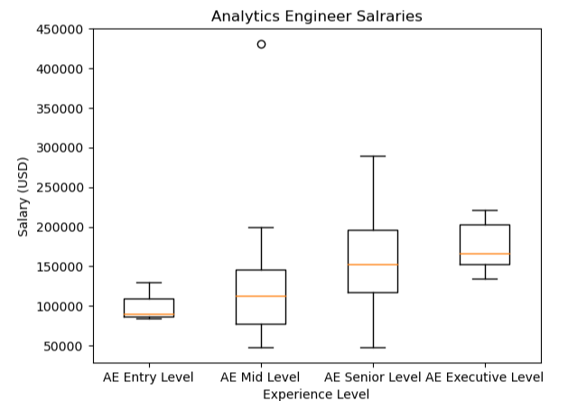
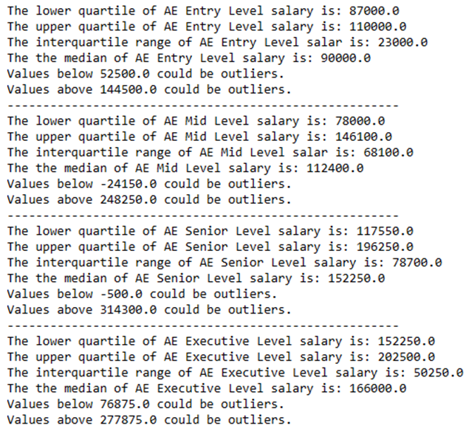
Analytics Engineer Salary Boxplot

Slide 4
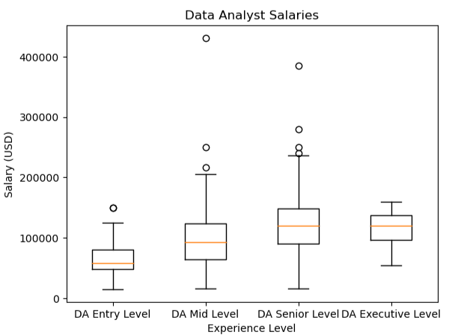
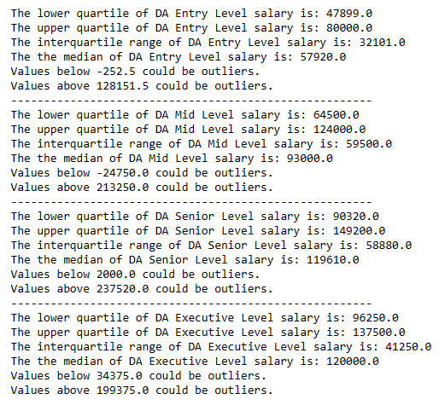
Data Analyst Salary Boxplot

Slide 5
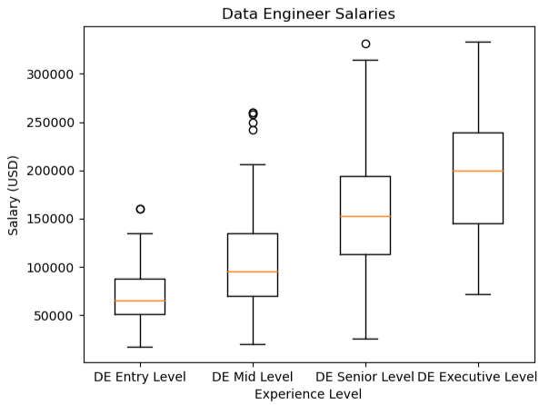
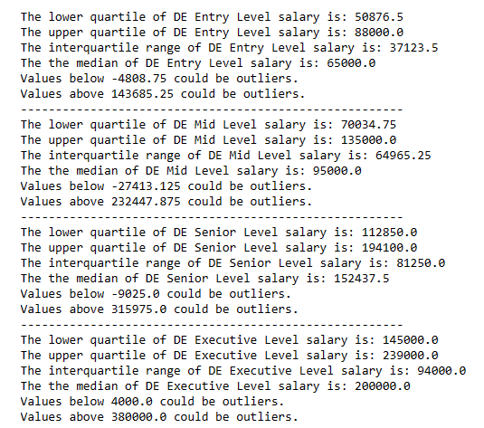
Data Engineer Salary Boxplot

Slide 6
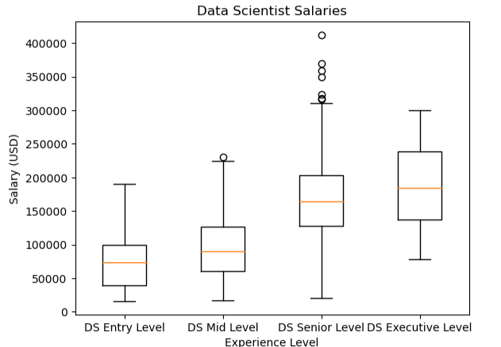
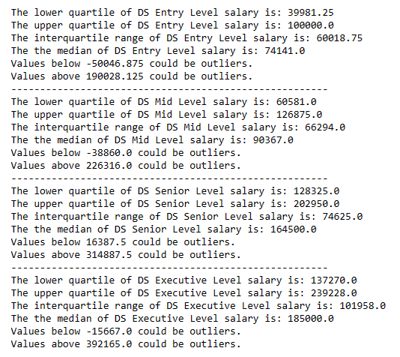
Data Scientist Salary Boxplot

Slide 7
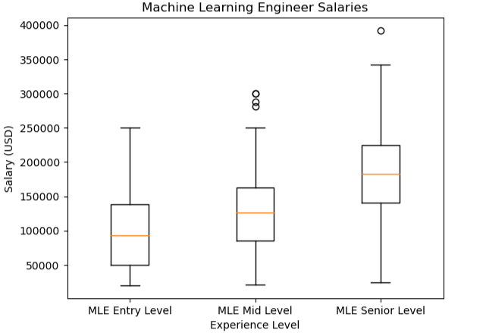
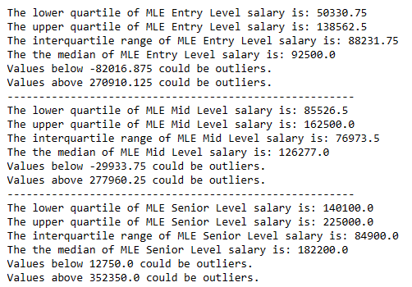
Machine Learning Engineer Salary Boxplot

Slide 8
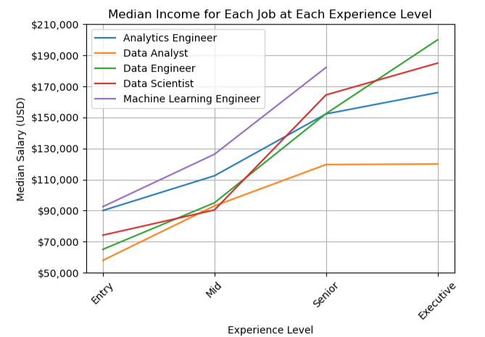
Median Income progression across job titles
-Further analysis here
-
-
-
-
-
-

